Slide 1

Java Socket Programming
Faculty of Information Technology
Hanoi University

Slide 2
Java Sockets Programming
The package java.net provides support for sockets programming (and more).
Typically you import everything defined in this package with:
import java.net.*;

Slide 3
Classes
InetAddress
Socket
ServerSocket DatagramSocket DatagramPacket

Slide 4
InetAddress class
static methods you can use to create new InetAddress objects.
getByName(String host)
getAllByName(String host)
getLocalHost()
InetAddress x = InetAddress.getByName(
“cse.unr.edu”);
Throws UnknownHostException

Slide 5
try {
InetAddress a = InetAddress.getByName(hostname); System.out.println(hostname + ":" + a.getHostAddress());
} catch (UnknownHostException e) {
System.out.println("No address found for " + hostname);
}
Java Socket Programming

Slide 6
Socket class
Corresponds to active TCP sockets only!
client sockets
socket returned by accept();
Passive sockets are supported by a different class:
ServerSocket
UDP sockets are supported by
DatagramSocket

Slide 7
JAVA TCP Sockets (Client Socket)
java.net.Socket
Implements client sockets (also called just “sockets”).
An endpoint for communication between two machines.
Constructor and Methods
Socket( String host, int port): Creates a stream socket and connects it to the specified port number on the named host.
Input Stream get Input Stream()
Output Stream get Output Stream()
close()

Slide 8
ServerSocket
java.net.ServerSocket
Implements server sockets.
Waits for requests to come in over the network.
Performs some operation based on the request.
Constructor and Methods
ServerSocket(int port)
Socket Accept(): Listens for a connection to be made to this socket and accepts it. This method blocks until a connection is made.
Internet

Slide 9
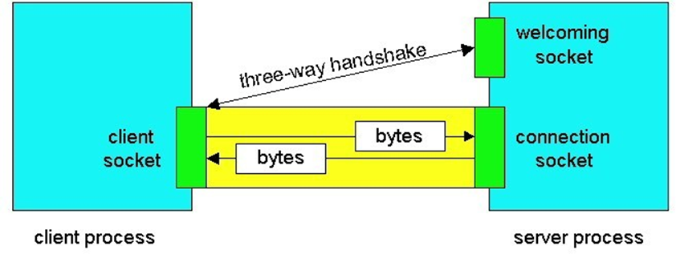
Sockets
Client socket, welcoming socket (passive) and connection socket (active)

Slide 10
Socket Constructors
Constructor creates a TCP connection to a named TCP server.
There are a number of constructors:
Socket(InetAddress server, int port); Socket(InetAddress server, int port,
InetAddress local, int localport);
Socket(String hostname, int port);

Slide 11
Socket Methods
void close();
InetAddress getInetAddress(); InetAddress getLocalAddress(); InputStream getInputStream(); OutputStream getOutputStream();
Lots more (setting/getting socket options, partial close, etc.)

Slide 12
Socket I/O
Socket I/O is based on the Java I/O support
in the package java.io
InputStream and OutputStream are abstract classes
common operations defined for all kinds of InputStreams, OutputStreams…

Slide 13
InputStream Basics
// reads some number of bytes and
// puts in buffer array b int read(byte[] b);
// reads up to len bytes
int read(byte[] b, int off, int len);
Both methods can throw IOException. Both return –1 on EOF.

Slide 14
OutputStream Basics
// writes b.length bytes void write(byte[] b);
// writes len bytes starting
// at offset off
void write(byte[] b, int off, int len);
Both methods can throw IOException.

Slide 15
ServerSocket Class
(TCP Passive Socket)
Constructors:
ServerSocket(int port); ServerSocket(int port, int backlog); ServerSocket(int port, int backlog,
InetAddress bindAddr);

Slide 16
ServerSocket Methods
Socket accept();
void close(); InetAddress getInetAddress();
int getLocalPort();
throw IOException, SecurityException

Slide 17
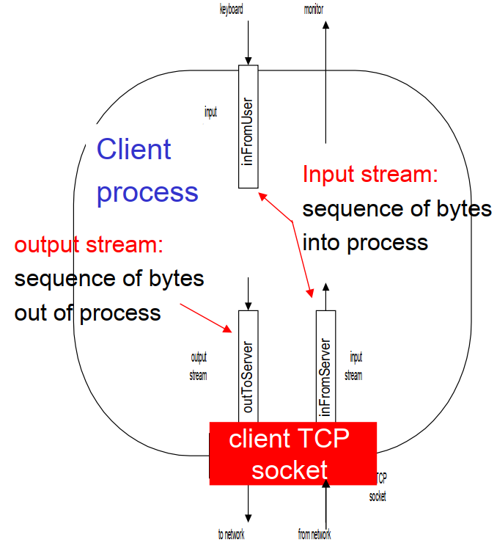
Socket programming with TCP
Example client-server app:
client reads line from standard input (inFrom User stream) , sends to server via socket (outTo Server stream)
server reads line from socket
server converts line to uppercase, sends back to client
client reads, prints modified line from socket (in From Server stream)

Slide 18
Client/server socket interaction: TCP
Server (running on hostid )
create socket, port=x ,
for incoming request: welcomeSocket = ServerSocket()
Client
TCP
connection setup
create socket,
connect to hostid, port=x
clientSocket = Socket()
wait for incoming connection request
connectionSocket =
welcomeSocket.accept()
send request using clientSocket
read request from connectionSocket
write reply to connectionSocket
read reply from clientSocket
close clientSocket
close connectionSocket

Slide 19
Sample Echo Server
TCPEchoServer.java And TCPClient.java
Save both files, compile and run on separate terminal. First TCPEchoServer and then TCPClient
Based on code from: TCP/IP Sockets in Java

Slide 20
TCPEchoServer.java
import java.io.*;
import java.net.*;
class TCPServer {
public static void main(String argv[]) throws Exception {
String clientSentence;
String capitalizedSentence;
ServerSocket welcomeSocket = new ServerSocket(6789);
System.out.println("Server is waiting to accept user... ");
while(true) {
Socket connectionSocket = welcomeSocket.accept();
System.out.println("Accept a client!");

Slide 21
BufferedReader inFromClient = new BufferedReader(new InputStreamReader(connectionSocket.getInputStream()));
DataOutputStream outToClient = new DataOutputStream(connectionSocket.getOutputStream());
clientSentence = inFromClient.readLine();
capitalizedSentence = clientSentence.toUpperCase() + "\n";
outToClient.writeBytes(capitalizedSentence);
}
}
}
Java Socket Programming
21

Slide 22
TCPClient.java
import java.io.*;
import java.net.*;
public class TCPClient {
public static void main(String argv[]) throws Exception {
String sentence;
String modifiedSentence;
BufferedReader inFromUser = new BufferedReader(new InputStreamReader(System.in));
while(true) {
System.out.println("Please enter your message");
Socket clientSocket = new Socket("localhost", 6789);
DataOutputStream outToServer = new DataOutputStream (clientSocket.getOutputStream());

Slide 23
BufferedReader inFromServer = new BufferedReader(new InputStreamReader(clientSocket.getInputStream()));
sentence = inFromUser.readLine();
outToServer.writeBytes(sentence + '\n');
modifiedSentence = inFromServer.readLine();
System.out.println("FROM SERVER: " + modifiedSentence);
//clientSocket.close();
}
}
}

Slide 24
UDP Sockets
DatagramSocket class
DatagramPacket class needed to specify the payload
incoming or outgoing

Slide 25
Socket Programming with UDP
UDP
ϖ
ϖ
ϖ
Connectionless and unreliable service. There isn’t an initial handshaking phase.
Transmitted data may be received out of order, or lost.
Socket Programming with UDP
ϖ
ϖ
ϖ
No need for a welcoming socket.
No streams are attached to the sockets.
The sending hosts creates “packets” by attaching the IP destination address and port number to each batch of bytes.
The receiving process must unravel to received packet to obtain the packet’s information bytes.
ϖ

Slide 26
JAVA UDP Sockets
In Package java.net
java.net.DatagramSocket
A socket for sending and receiving datagram packets.
Constructor and Methods
DatagramSocket(int port): Constructs a datagram socket and binds it to the specified port on the local host machine.
void receive (DatagramPacket p)
void send (DatagramPacket p)
void close()

Slide 27
DatagramSocket Constructors
DatagramSocket();
DatagramSocket(int port); DatagramSocket(int port, InetAddress a);
All can throw SocketException or SecurityException

Slide 28
Datagram Methods
void connect(InetAddress, int port);
void close();
void receive(DatagramPacket p); void send(DatagramPacket p);
Lots more!

Slide 29
DatagramPacket
Contain the payload
(a byte array, length of byte array, InetAddress, port)
Can also be used to specify the destination address
when not using connected mode UDP

Slide 30
DatagramPacket Constructors
For receiving:
DatagramPacket( byte[] buf, int len);
For sending:
DatagramPacket( byte[] buf, int len
InetAddress a, int port);

Slide 31
DatagramPacket methods
byte[] getData();
void setData(byte[] buf);
void setAddress(InetAddress a); void setPort(int port);
InetAddress getAddress(); int getPort();

Slide 32
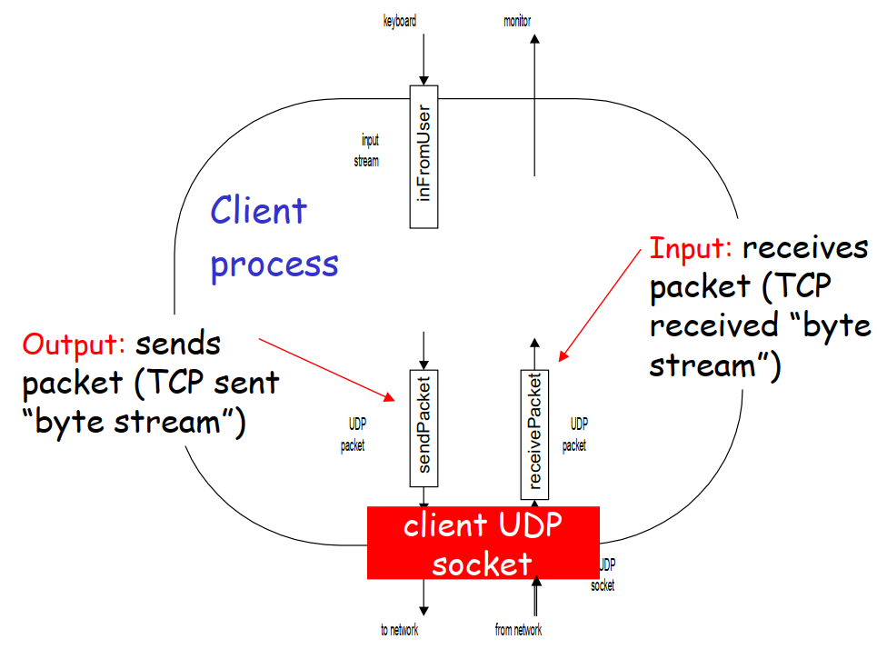
Example: Java client (UDP)

Slide 33
Client/server socket interaction: UDP
Server (running on hostid )
create socket, port=x , for incoming request: serverSocket = DatagramSocket()
Client
create socket,
clientSocket = DatagramSocket()
Create, address (hostid, port=x, send datagram request
using clientSocket
read request from serverSocket
write reply to serverSocket specifying client host address, port umber
read reply from clientSocket
close clientSocket

Slide 34
Sample UDP code
UDPEchoServer.java
Simple UDP Echo server.
Test using nc as the client (netcat):
nc –u hostname port

Slide 35
UDPEchoServer.java
import java.io.*;
import java.net.*;
class UDPEchoServer {
public static void main(String args[]) throws Exception {
int port = 9876;
DatagramSocket serverSocket = new DatagramSocket(port);
byte[] receiveData = new byte[1024];
byte[] sendData = new byte[1024];

Slide 36
while(true) {
DatagramPacket receivePacket = new DatagramPacket (receiveData, receiveData.length);
serverSocket.receive(receivePacket);
String sentence = new String(receivePacket.getData());
InetAddress IPAddress = receivePacket.getAddress();
int clientPort = receivePacket.getPort();
String capitalizedSentence = sentence.toUpperCase();
sendData = capitalizedSentence.getBytes();
DatagramPacket sendPacket = new DatagramPacket (sendData, sendData.length, IPAddress, clientPort);
serverSocket.send(sendPacket);
}
}
}
Java Socket Programming
36

Slide 37
UDPClient.java
import java.io.*;
import java.net.*;
public class UDPClient {
public static void main(String args[]) throws Exception {
BufferedReader inFromUser = new BufferedReader(new InputStreamReader (System.in));
int port = 9876;
DatagramSocket clientSocket = new DatagramSocket();
InetAddress IPAddress = InetAddress.getByName("localhost");
byte[] sendData = new byte[1024];
byte[] receiveData = new byte[1024];

Slide 38
while(true) {
System.out.println("Please enter your message");
String sentence = inFromUser.readLine();
sendData = sentence.getBytes();
DatagramPacket sendPacket = new DatagramPacket (sendData, sendData.length, IPAddress, port);
clientSocket.send(sendPacket);
DatagramPacket receivePacket = new DatagramPacket (receiveData, receiveData.length);
clientSocket.receive(receivePacket);
String modifiedSentence = new String(receivePacket.getData());
System.out.println("FROM SERVER:" + modifiedSentence);
//clientSocket.close();
}
}
}

Slide 39
Socket functional calls
socket (): Create a socket
bind(): bind a socket to a local IP address and port #
listen(): passively waiting for connections
connect(): initiating connection to another socket
accept(): accept a new connection
Write(): write data to a socket
Read(): read data from a socket
sendto(): send a datagram to another UDP socket
recvfrom(): read a datagram from a UDP socket
close(): close a socket (tear down the connection)

Slide 40
Java URL Class
Represents a Uniform Resource Locator
scheme (protocol)
hostname
port
path
query string

Slide 41
Parsing
You can use a URL object as a parser:
URL u = new URL(“http://www.cs.unr.edu/”); System.out.println(“Proto:” + u.getProtocol()); System.out.println(“File:” + u.getFile());

Slide 42
URL construction
You can also build a URL by setting each part individually:
URL u = new URL(“http”,
www.cs.unr.edu,80,”/~mgunes/”);
System.out.println(“URL:” + u.toExternalForm()); System.out.println(“URL: “ + u);

Slide 43
Retrieving URL contents
URL objects can retrieve the documents they refer to!
actually this depends on the protocol part of the URL.
HTTP is supported
File is supported (“file://c:\foo.html”)
You can get “Protocol Handlers” for other protocols.
There are a number of ways to do this:
Object getContent(); InputStream openStream(); URLConnection openConnection();

Slide 44
Getting Header Information
There are methods that return information extracted from response headers:
String getContentType(); String getContentLength(); long getLastModified();

Slide 45
URLConnection
Represents the connection (not the URL itself).
More control than URL
can write to the connection (send POST data).
can set request headers.
Closely tied to HTTP

